Slide 1


PYTHON
Lecture 49

Slide 2

Today’s Agenda
Exception Handling
Using Exception Object
Getting Details Of Exception
Raising An Exception
Using finally Block
Creating User Defined Exceptions

Slide 3
Using Exception Object
Now we know how to handle exception, in this section we will learn how to access exception object in exception handler code.
To access the exception object created by Python we can use the keyword as and assign it to a variable.
Finally using that variable we can get the details of the exception

Slide 4
Example
while(True):
try:
a=int(input("Input first no:"))
b=int(input("Input second no:"))
c=a/b
print("Div is ",c)
break;
except (ValueError,ZeroDivisionError) as e:
print(e)

Slide 5
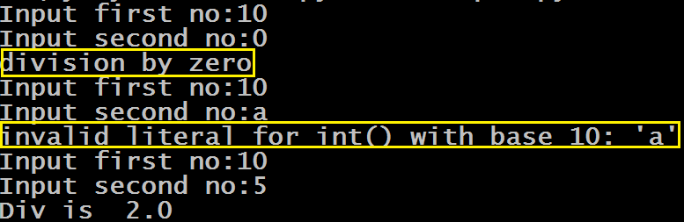
Sample Output

Slide 6
Obtaining Exception Details
Python allows us to get more details about the exception by calling the function exc_info().
Following are it’s important points:
It is available in the module sys
It returns a tuple containing 3 items called type, value and traceback
The variable type is the name of exception class, value is the instance of exception class and traceback contains the complete trace of the exception

Slide 7
Example
while(True):
try:
a=int(input("Input first no:"))
b=int(input("Input second no:"))
c=a/b
print("Div is ",c)
break;
except:
a,b,c=sys.exc_info()
print("Exception class:",a)
print("Exception message:",b)
print("Line number:",c.tb_lineno)

Slide 8
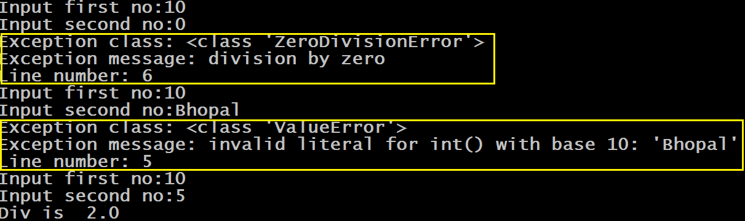
Sample Output

Slide 9
Obtaining Exception Details Using traceback class
Sometimes , we need to print the details of the exception exactly like Python does .
We do this normally , when we are debugging our code.
The class traceback which is available in the module traceback helps us do this

Slide 10
Obtaining Exception Details Using traceback class
This class contains a method called format_exc( )
It is a class method of traceback class and returns complete details of the exception as a string.
This string contains:
The program name in which exception occurred
Line number where exception occurred
The code which generated the exception
The name of the exception class
The message related to the exception

Slide 11
Example
while(True):
try:
a=int(input("Input first no:"))
b=int(input("Input second no:"))
c=a/b
print("Div is ",c)
break;
except:
print(traceback.format_exc())

Slide 12
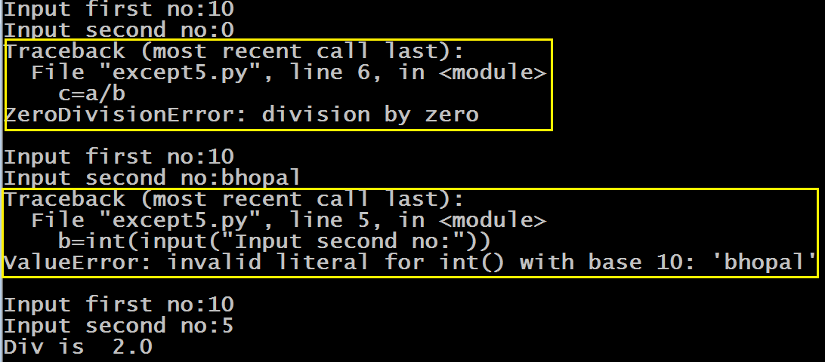
Sample Output

Slide 13
Raising An Exception
We can force Python to generate an Exception using the keyword raise.
This is normally done in those situations where we want Python to throw an exception in a particular condition of our choice
Syntax:
raise ExceptionClassName
raise ExceptionClassName( message )

Slide 14
Exercise
Write a program to ask the user to input 2 integers and calculate and print their division. Make sure your program behaves as follows:
If the user enters a non integer value then ask him to enter only integers
If denominator is 0 , then ask him to input non-zero denominator
If any of the numbers is negative then display the message negative numbers not allowed
Repeat the process until correct input is given
Only if the inputs are correct then display their division and terminate the code

Slide 15
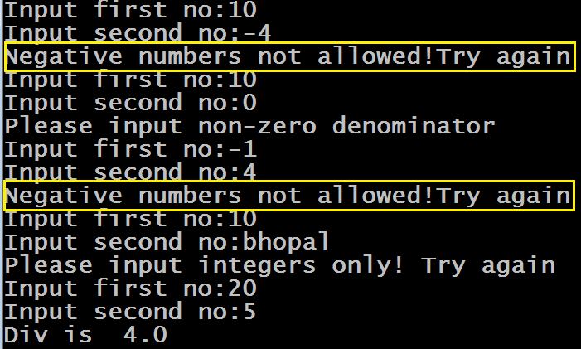
Sample Output

Slide 16
Solution
while(True):
try:
a=int(input("Input first no:"))
b=int(input("Input second no:"))
if a<0 or b<0:
raise Exception("Negative numbers not allowed!Try again")
c=a/b
print("Div is ",c)
break;
except ValueError:
print("Please input integers only! Try again")
except ZeroDivisionError:
print("Please input non-zero denominator")
except Exception as e:
print(e)

Slide 17
The finally Block
If we have a code which we want to run in all situations, then we should write it inside the finally block.
Python will always run the instructions coded in the finally block.
It is the most common way of doing clean up tasks , like, closing a file or disconnecting with the DB or logging out the user etc

Slide 18
Syntax Of The finally Block
The finally block has 2 syntaxes:
Syntax 1
try:
# some exception generating code
except :
# exception handling code
finally:
# code to be always executed
Syntax 2
try:
# some exception generating code
finally:
# code to be always executed

Slide 19
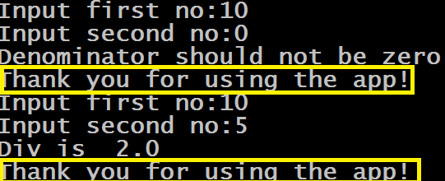
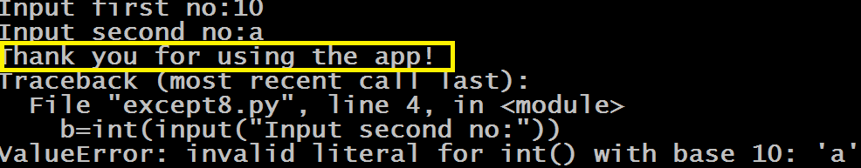
Guess The Output ?
while(True):
try:
a=int(input("Input first no:"))
b=int(input("Input second no:"))
c=a/b
print("Div is ",c)
break;
except ZeroDivisionError:
print("Denominator should not be zero")
finally:
print("Thank you for using the app!")
Output:

Slide 20
Creating User Defined Exception
Python has many built-in exceptions which forces our program to output an error when something in it goes wrong.
However, sometimes we may need to create our own exceptions which will be more suitable for our purpose.
Such exceptions are called User Defined Exceptions

Slide 21
Creating User Defined Exception
In Python, users can define such exceptions by creating a new class.
This exception class has to be derived, either directly or indirectly, from Exception class.
Most of the built-in exceptions are also derived form this class.

Slide 22
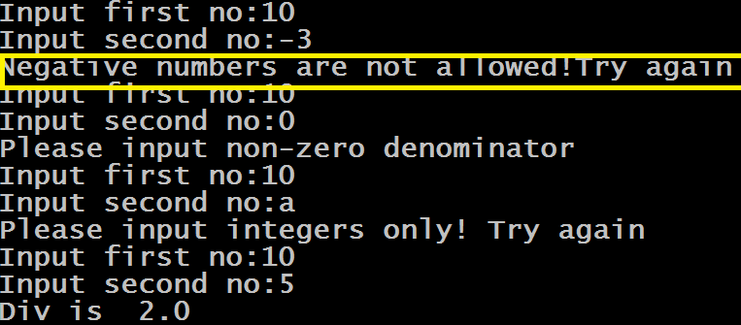
Example
class NegativeNumberException(Exception):
pass
while(True):
try:
a=int(input("Input first no:"))
b=int(input("Input second no:"))
if a<0 or b<0:
raise NegativeNumberException("Negative numbers are not allowed!Try again")
c=a/b
print("Div is ",c)
break;
except ValueError:
print("Please input integers only! Try again")
except ZeroDivisionError:
print("Please input non-zero denominator")
except NegativeNumberException as e:
print(e)

